Slide 1
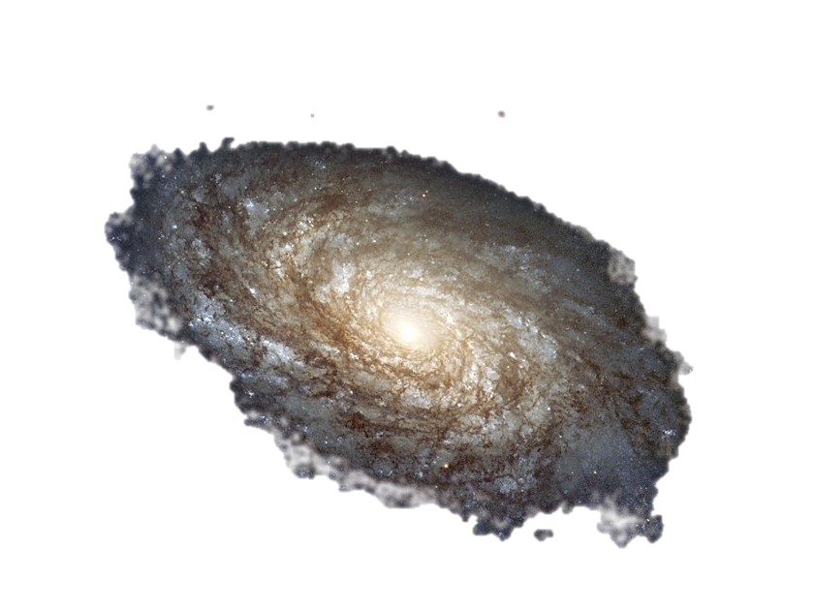
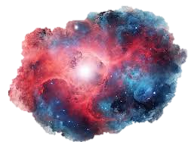

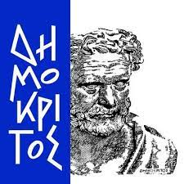
Stellar Signatures
Object Detection and Classification in Space and Deep Space Imagery using Deep Learning
Foukanelis Christos (mtn2324)
Vytiniotis Konstantinos (mtn2308)
DEMOKRITOS
NATIONAL CENTRE FOR SCIENTIFIC RESEARCH

Slide 2
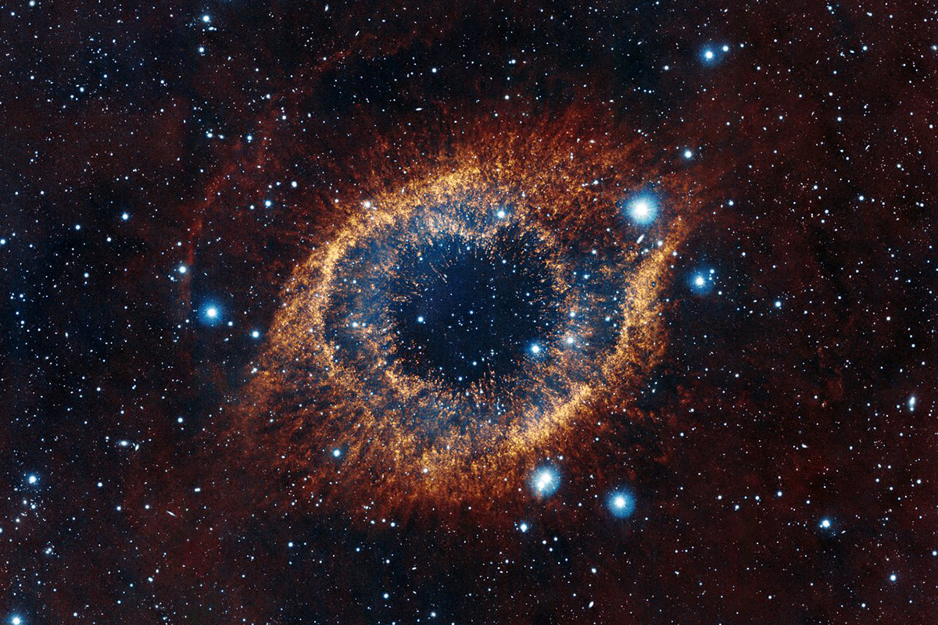
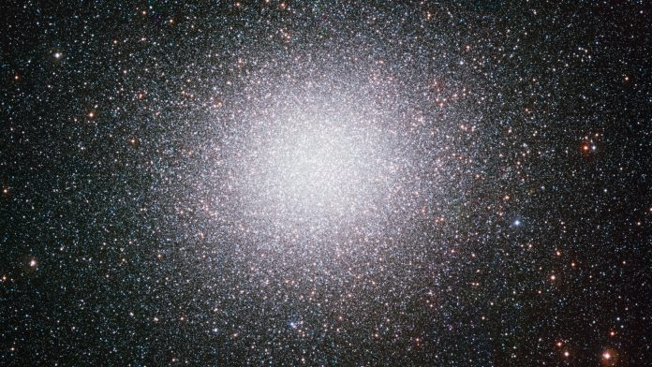
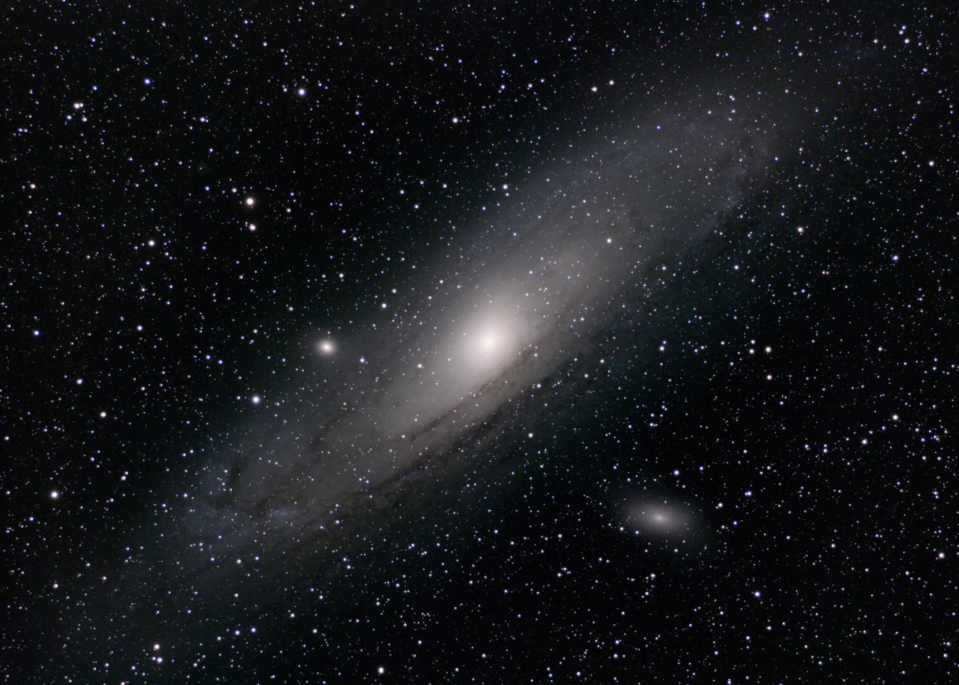
Agenda
Problem Statement
Dataset Overview
YOLOv8
Faster R-CNN ResNet-50
Custom YOLOv3
Comparative Analysis
Conclusions

Slide 3
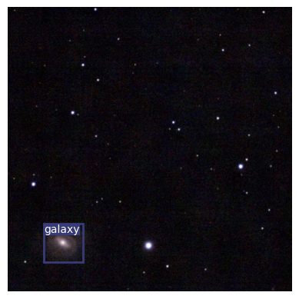
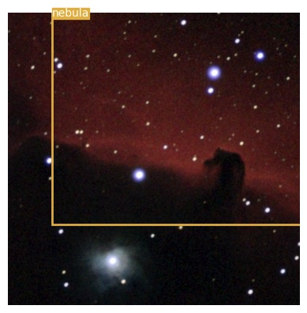
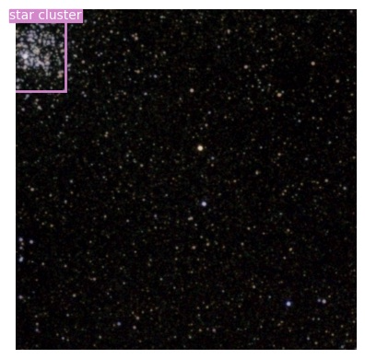
Problem Statement
Task
Stellar Object Detection
Bounding Box Regression + Object Classification
Distinguish between faint stars/dots/black background and deep space objects
These are YOLOv3 model predictions!

Slide 4
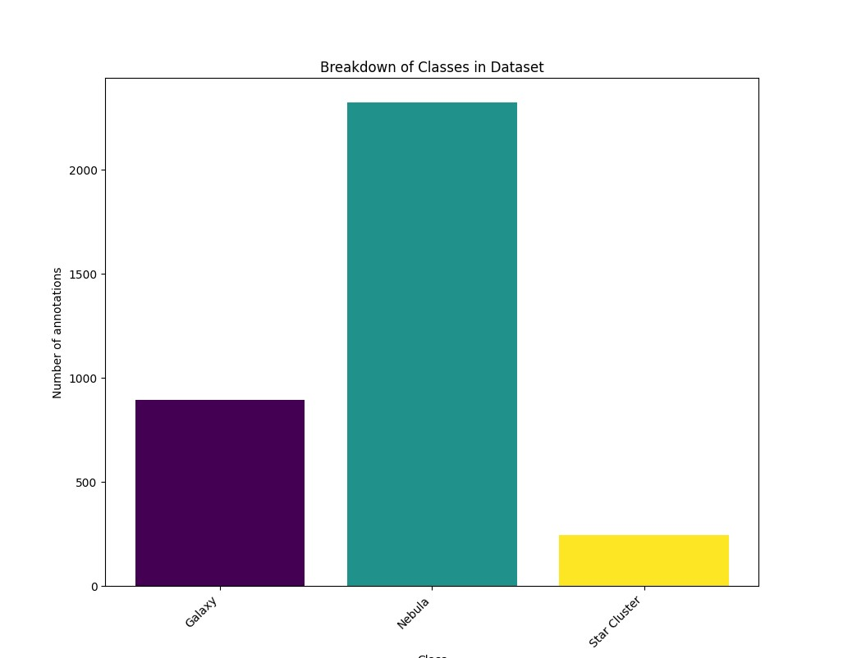


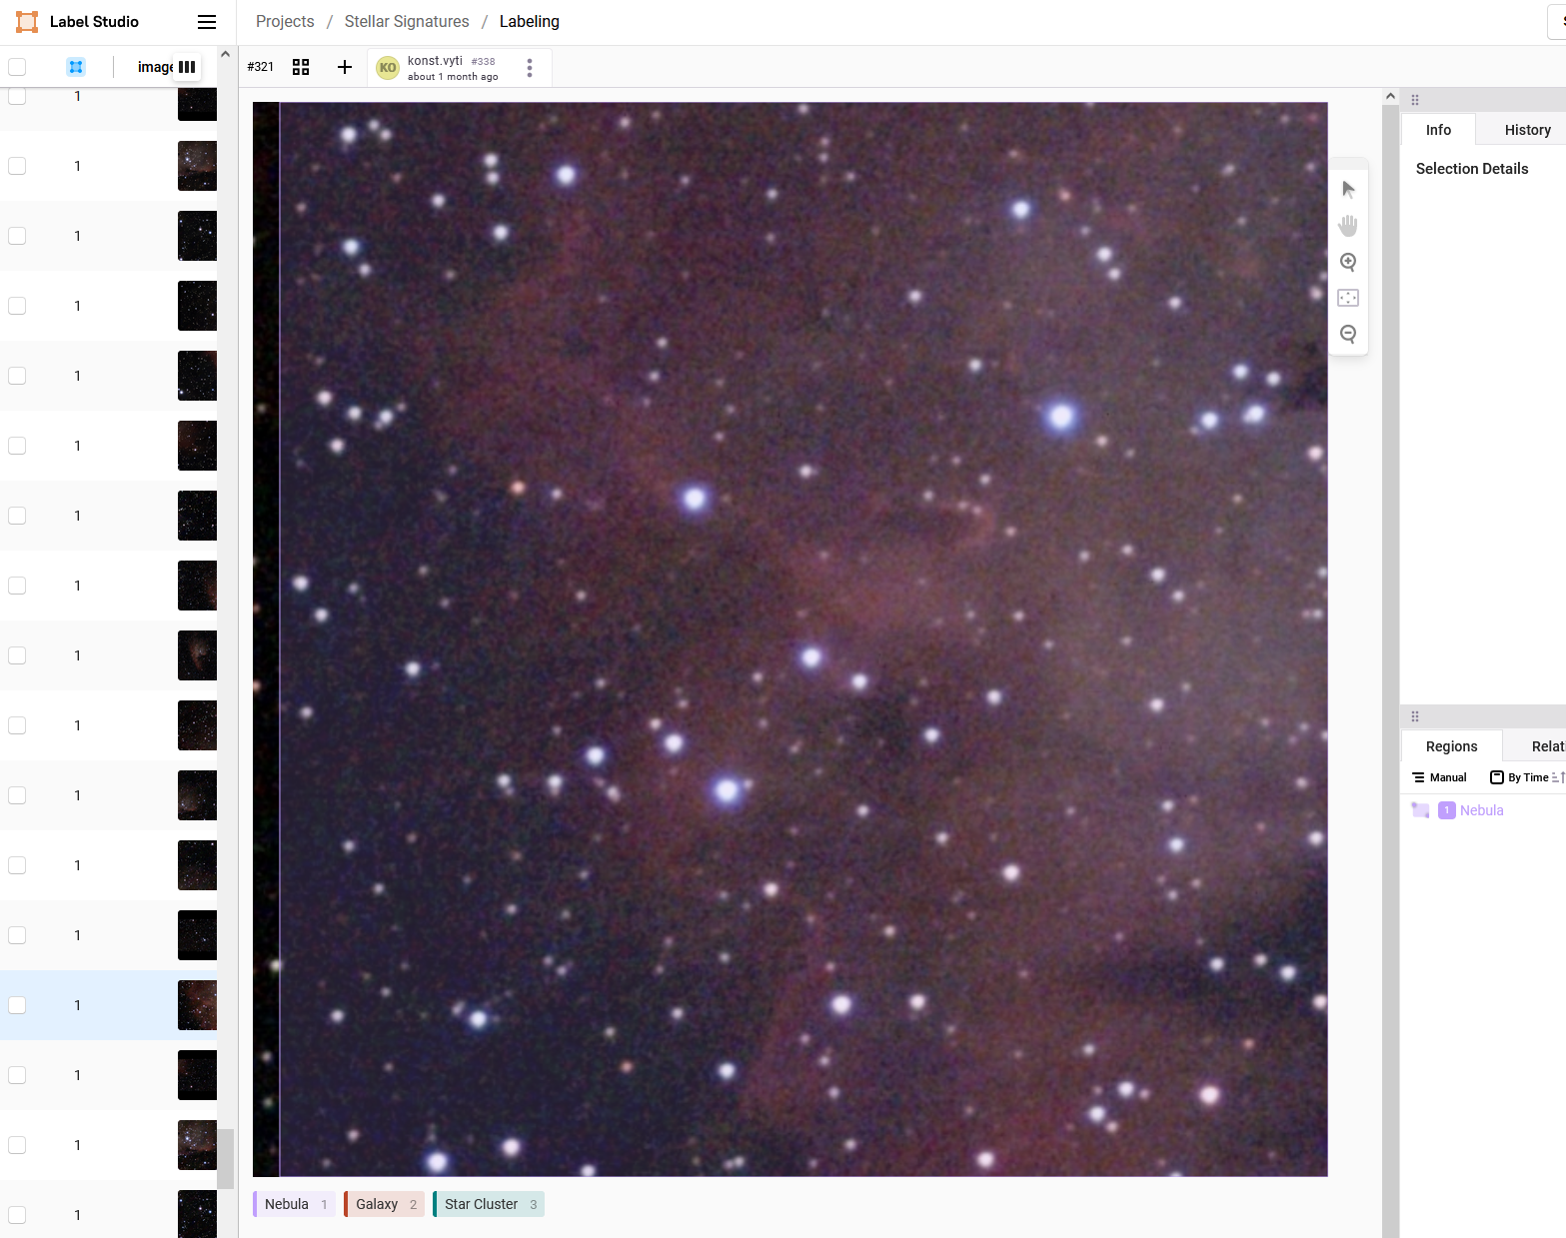
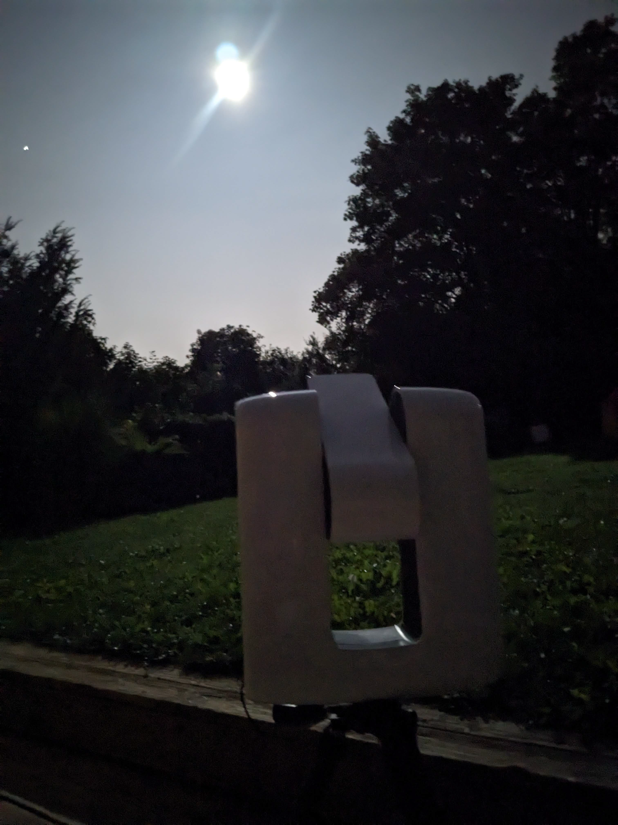
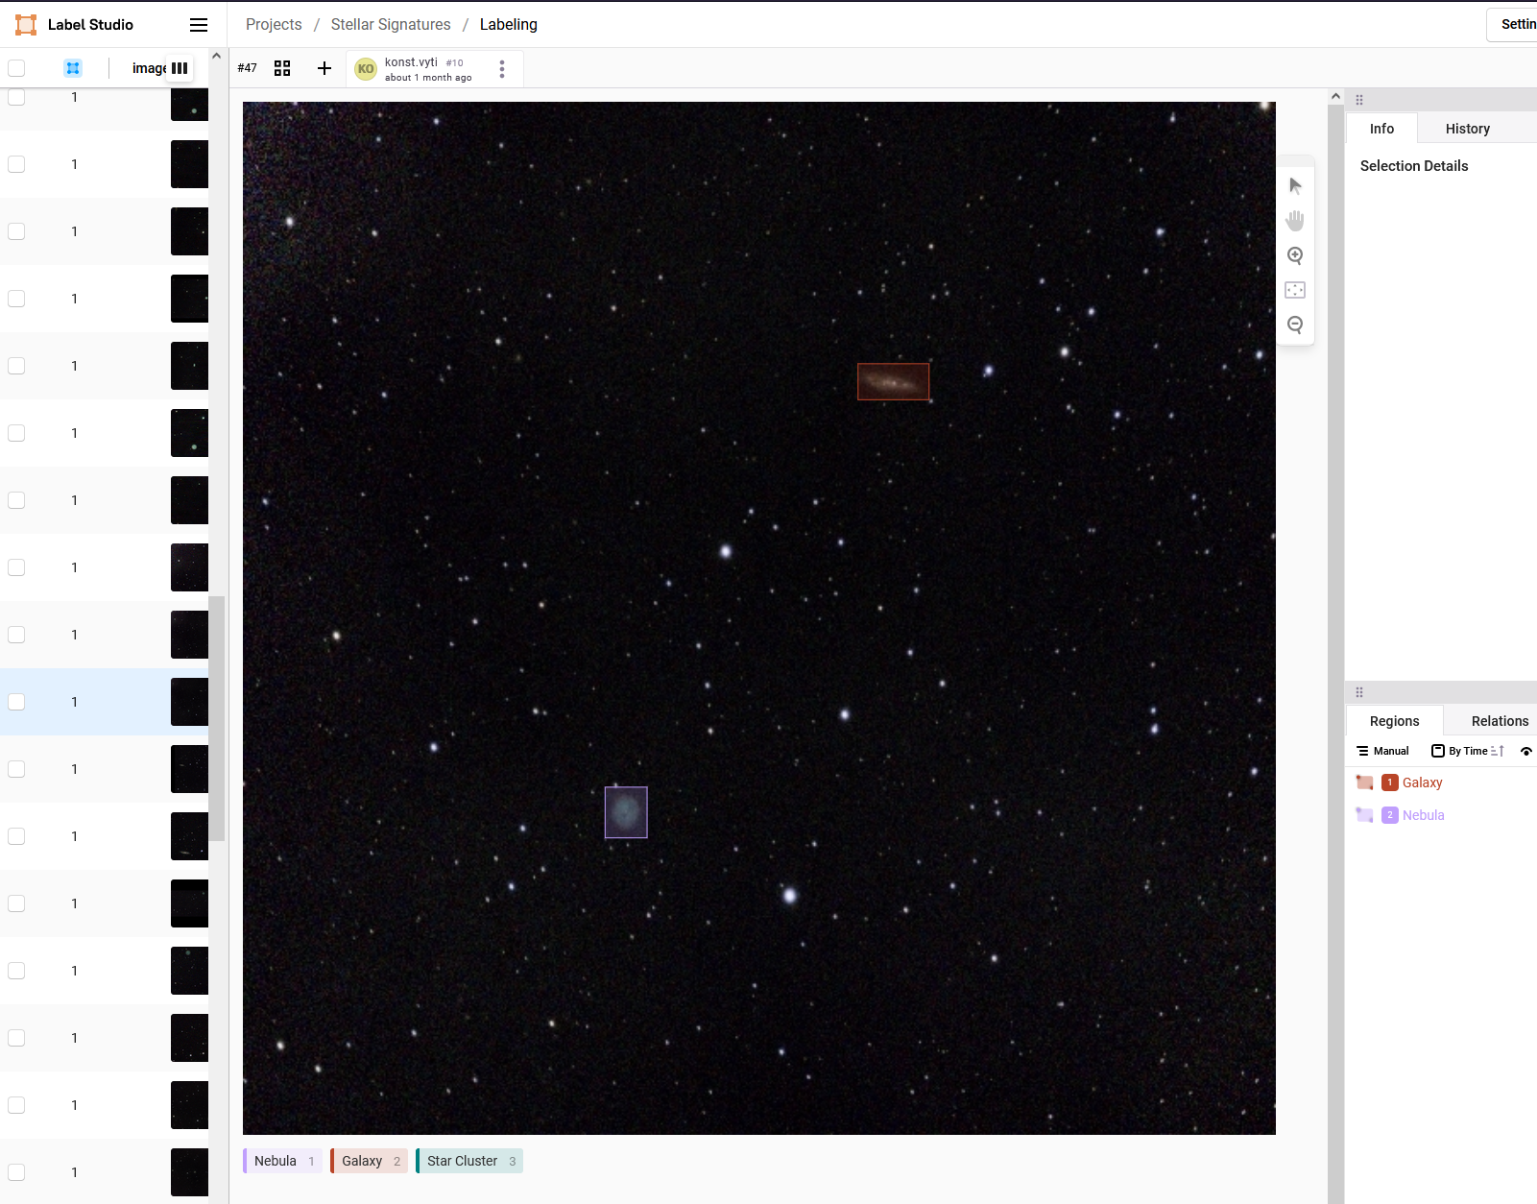
Dataset Overview
DeepSpaceYoloDataset
~4,600 images capturing various celestial objects
Dataset annotated from scratch to fit our needs using Label Studio
Classes
Galaxy
Nebulae
Star Cluster
Utilized COCO & YOLO formats
RGB images of size 608 x 608 pixels
Source: DeepSpaceYoloDataset

Slide 5
YOLOv8 (1)
Pretrained model
Trained on the COCO dataset which includes 80 classes
Series of Convolutional layers followed by detection layers
Model was further trained on DeepSpaceYoloDataset for 10 & 20 epochs

Slide 6
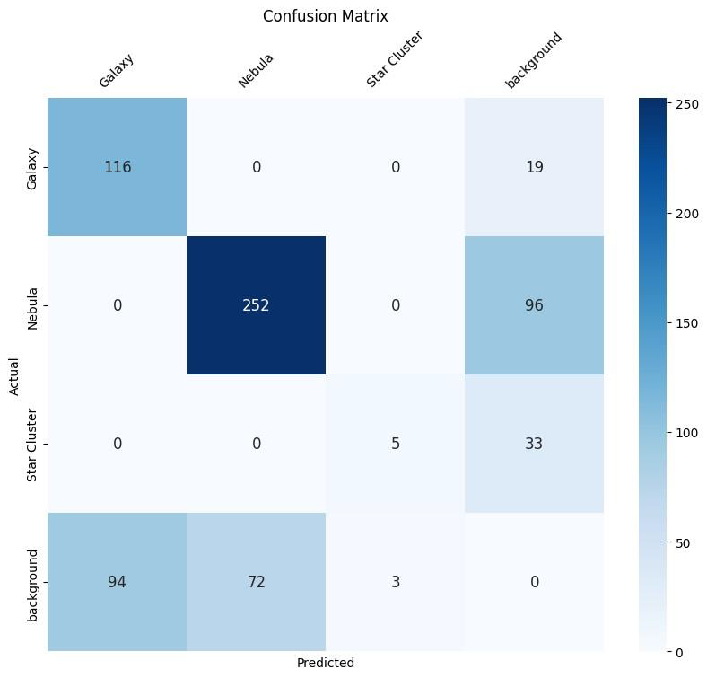
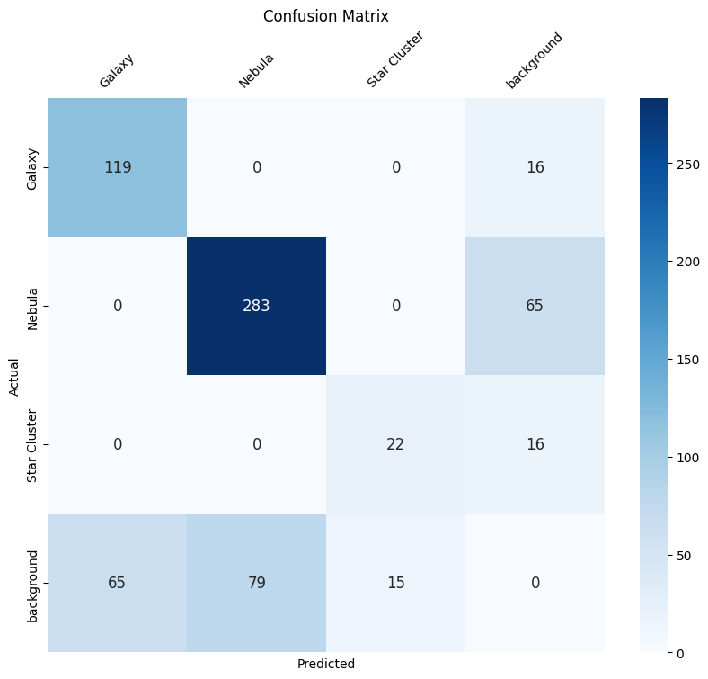
YOLOv8 (2)
Training losses – 10 epochs
Confusion Matrix – 10 epochs
Training losses – 20 epochs
Confusion Matrix – 20 epochs

Slide 7
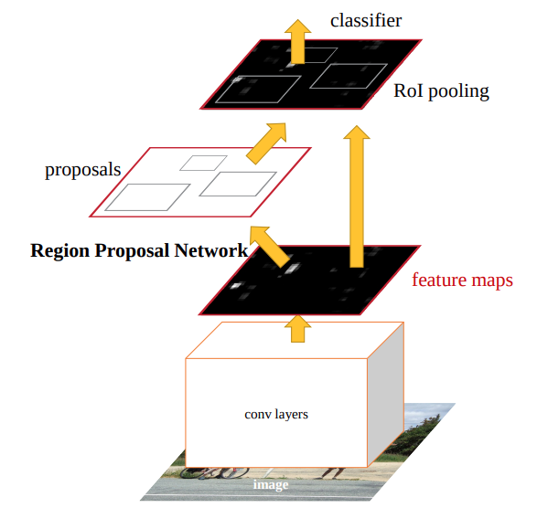
Faster R-CNN ResNet-50
Operates in 2 stages (RPN – Classification)
ResNet-50 backbone network
More complex than YOLO
Requires more data for fine-tuning
Can be scaled up with deeper backbones or down for faster performance

Slide 8
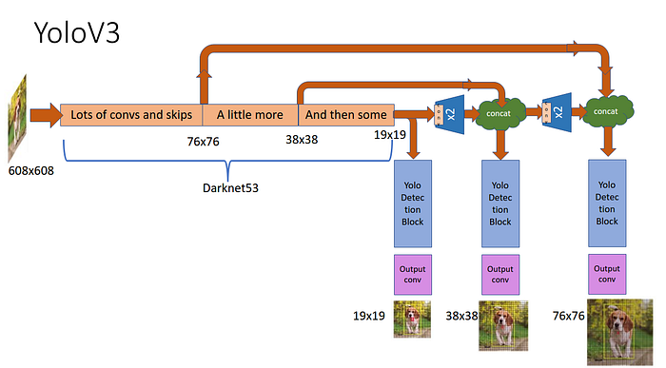
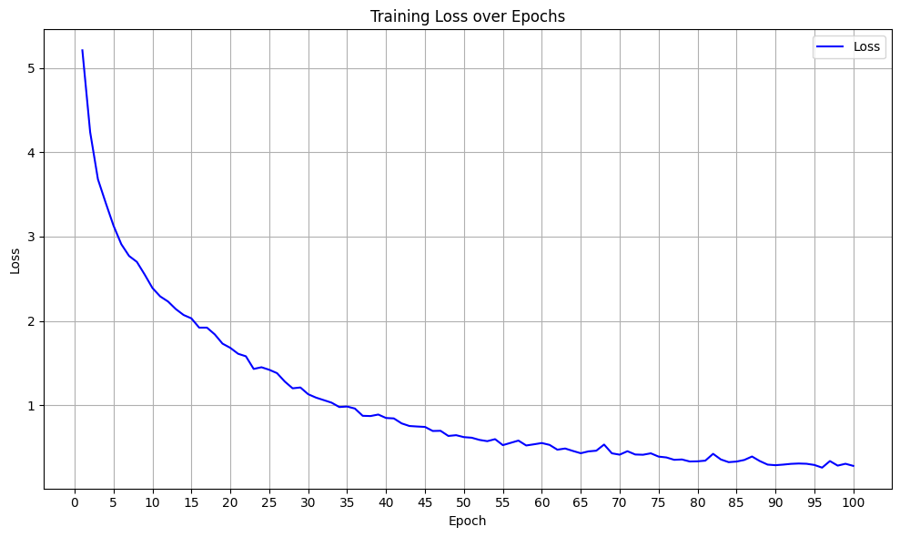
Custom YOLOv3
Model Implemented from scratch – no pretraining
DarkNet53 Backbone implemented and trained form scratch
Fast and Accurate – Unified Architecture (bbox regression and classification heads unified)
Very promising results
Non-Maximum Suppression Applied
Training epochs: 100

Slide 9
Comparative Analysis
Key Takeaways
YOLOv8 outperformed Faster R-CNN ResNet-50 in terms of F1-score
The improvement in F1-score with more epochs indicate that longer training can enhance model performance
YOLOv3 captured features effectively
Class imbalance was the primary challenge
Architecture | YOLOv8 (10 epochs) | YOLOv8 (20 epochs) | Faster R-CNN ResNet-50 (10 epochs) | Faster R-CNN ResNet-50 (20 epochs) | Custom YOLOv3 (100 epochs)
F1-Score | 0.70 | 0.81 | 0.26 | 0.36 | 0.61
Training Time (A100) | ~28m | ~45m | ~1h | ~2h | ~8h

Slide 10
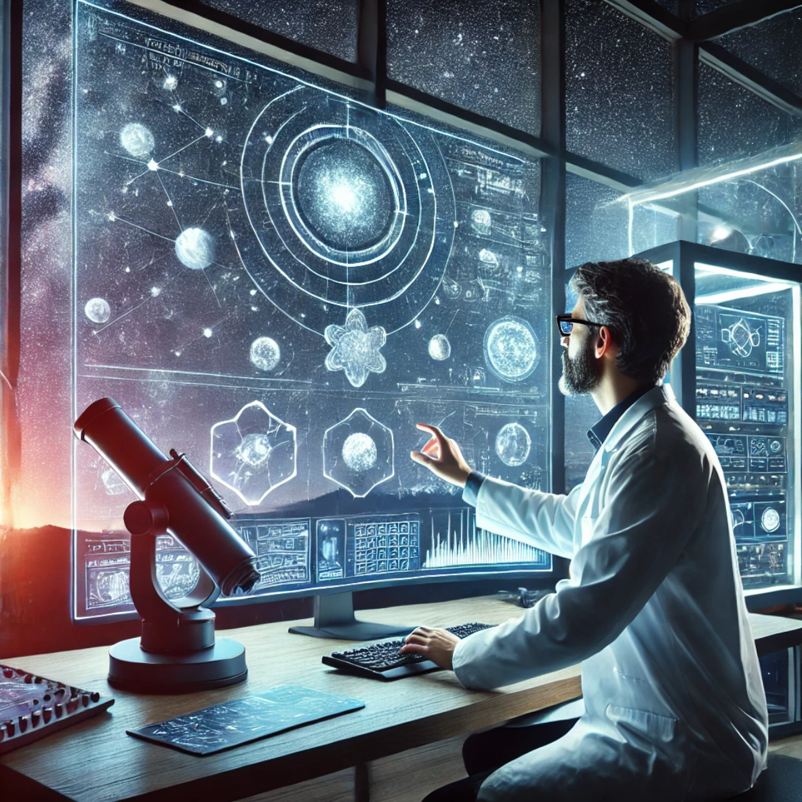
Conclusions
Conclusions
Pretrained models yielded better performance
Even models trained from scratch have a lot of potential
The task of detecting and classifying these 3 objects is achievable with very good results on non large scale data
Astronomy Applications
Challenges
Class imbalance
Faint and hard to distinguish objects
Computational complexity
Improvements
Dataset enrichment
More advanced architectures
More advanced annotations

Slide 11

Q & A
Thank You!

